Slide 1
Topic 2: Combinational Logic Circuit
Analysis and design of combinational logic circuit
Hazard

Slide 2
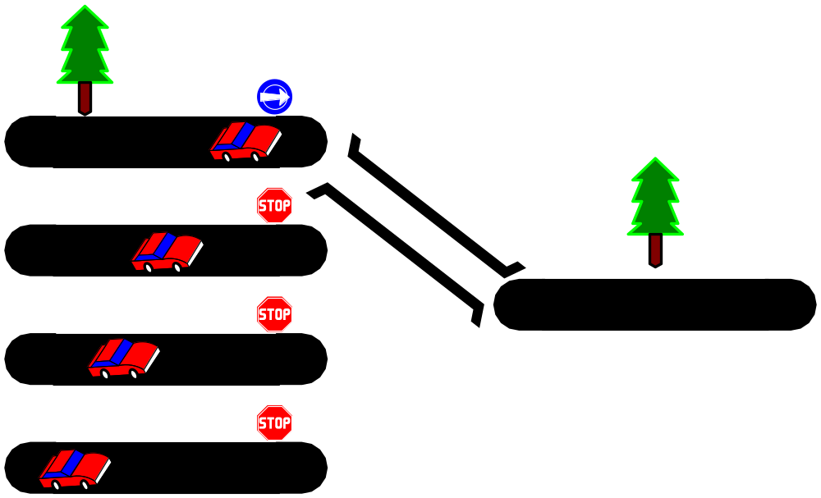
Multiplexers
A multiplexer (MUX) is a device that allows digital information from several sources to be routed onto a single line. The basic multiplexer has several data-input lines and a single output line. It also has data-select inputs, which permit digital data on any one of the inputs to be switched to the output line. Multiplexers are also known as data selectors.
MUX
S₁ S₀ | Y
0 0 | I₀
0 1 | I₁
1 0 | I₂
1 1 | I₃
I₀
I₁
I₂
I₃
Y
S₁ S₀
<number> / 65
Notes:
Princess Sumaya University
4241 - Digital Logic Design
Dr. Bassam Kahhaleh

Slide 3
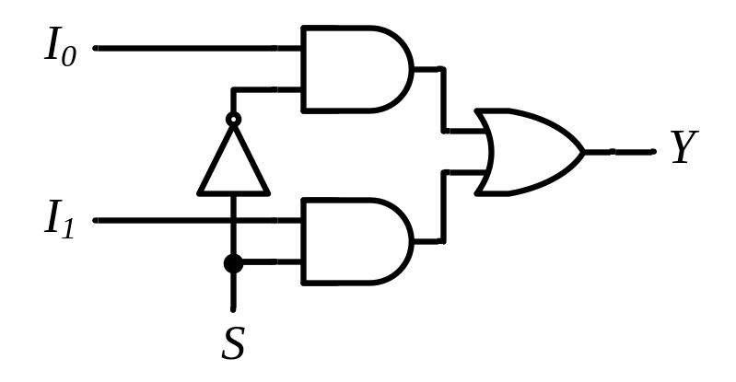
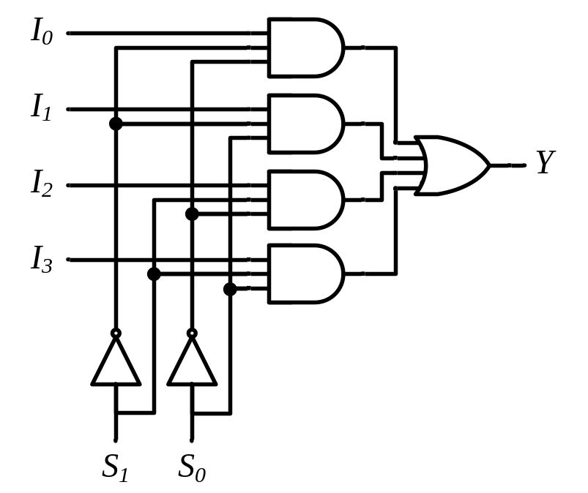
Multiplexers
2-to-1 MUX
4-to-1 MUX
MUX
I₀
I₁
Y
S
MUX
I₀
I₁
I₂
I₃
Y
S₁ S₀
<number> / 65
Notes:
Princess Sumaya University
4241 - Digital Logic Design
Dr. Bassam Kahhaleh

Slide 4
Implementation Using Multiplexers
Example
F(x, y) = ∑(0, 1, 3)
x y | F
0 0 | 1
0 1 | 1
1 0 | 0
1 1 | 1
MUX
1
1
0
1
I₀
I₁
I₂
I₃
Y
F
S₁ S₀
x y
<number> / 65
Notes:
Princess Sumaya University
4241 - Digital Logic Design
Dr. Bassam Kahhaleh

Slide 5
Implementation Using Multiplexers (8:1)
Example
F(x, y, z) = ∑(1, 2, 6, 7)
MUX
0
1
1
0
0
0
1
1
I₀
I₁
I₂
I₃ I₄
I₅
I₆
I₇
x y z | F
0 0 0 | 0
0 0 1 | 1
0 1 0 | 1
0 1 1 | 0
1 0 0 | 0
1 0 1 | 0
1 1 0 | 1
1 1 1 | 1
Y
F
S₂ S₁ S₀
x y z
<number> / 65
Notes:
Princess Sumaya University
4241 - Digital Logic Design
Dr. Bassam Kahhaleh

Slide 6
Implementation Using Multiplexers (4:1)
Example
F(x, y, z) = ∑(1, 2, 6, 7)
x y z | F
0 0 0 | 0
0 0 1 | 1
0 1 0 | 1
0 1 1 | 0
1 0 0 | 0
1 0 1 | 0
1 1 0 | 1
1 1 1 | 1
z
MUX
I₀
I₁
I₂
I₃
F = z
F
z
0
Y
F = z
1
S₁ S₀
F = 0
x y
F = 1
<number> / 65
Notes:
Princess Sumaya University
4241 - Digital Logic Design
Dr. Bassam Kahhaleh

Slide 7
Implementation Using Multiplexers (8:1)
Example
F(A, B, C, D) = ∑(1, 3, 4, 11, 12, 13, 14, 15)
A B C D | F
0 0 0 0 | 0
0 0 0 1 | 1
0 0 1 0 | 0
0 0 1 1 | 1
0 1 0 0 | 1
0 1 0 1 | 0
0 1 1 0 | 0
0 1 1 1 | 0
1 0 0 0 | 0
1 0 0 1 | 0
1 0 1 0 | 0
1 0 1 1 | 1
1 1 0 0 | 1
1 1 0 1 | 1
1 1 1 0 | 1
1 1 1 1 | 1
MUX
D
I₀
I₁
I₂
I₃ I₄
I₅
I₆
I₇
F = D
D
F = D
D
F = D
0
Y
F
0
F = 0
D
F = 0
1
F = D
1
S₂ S₁ S₀
F = 1
F = 1
A B C
<number> / 65
Notes:
Princess Sumaya University
4241 - Digital Logic Design
Dr. Bassam Kahhaleh

Slide 8
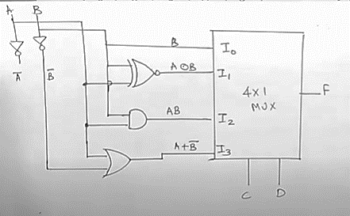
Implementation Using Multiplexers (4:1)
Example
F(A, B, C, D) = ∑(1,3,4,11,12,13,14,15)
AB | CD
 | I0 | I1 | I3 | I2
 | 00 | 01 | 11 | 10
00 |  | 1 | 1
01 | 1
11 | 1 | 1 | 1 | 1
10 |  |  | 1
 | B | AB+A’B’ | A+B’ | AB
<number> / 65
Notes:
Princess Sumaya University
4241 - Digital Logic Design
Dr. Bassam Kahhaleh

Slide 9
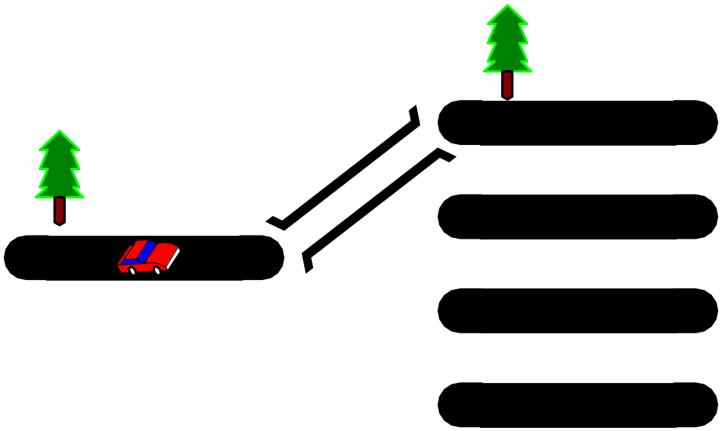
DeMultiplexers
A demultiplexer (DEMUX) basically reverses the multiplexing function. It takes digital information from one line and distributes it to a given number of output lines. For this reason, the demultiplexer is also known as a data distributor.
<number> / 65
Notes:
Princess Sumaya University
4241 - Digital Logic Design
Dr. Bassam Kahhaleh

Slide 10
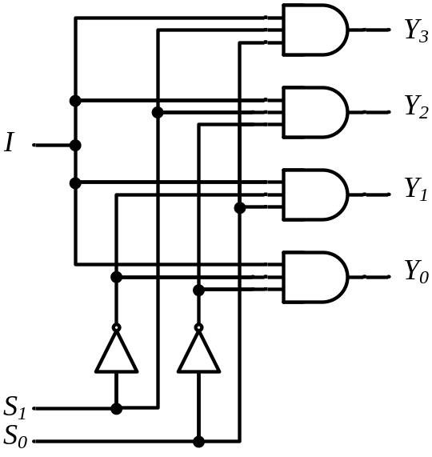
DeMultiplexers
DeMUX
Y₃
Y₂
Y₁
Y₀
I
S₁ S₀
S₁ S₀ | Y₃ | Y₂ | Y₁ | Y₀
0 0 | 0 | 0 | 0 | I
0 1 | 0 | 0 | I | 0
1 0 | 0 | I | 0 | 0
1 1 | I | 0 | 0 | 0
<number> / 65
Notes:
Princess Sumaya University
4241 - Digital Logic Design
Dr. Bassam Kahhaleh

Slide 11

Multiplexer / DeMultiplexer Pairs
MUX
DeMUX
Y₇
Y₆
Y₅
Y₄ Y₃
Y₂
Y₁
Y₀
7
7
I₇
I₆
I₅
I₄ I₃
I₂
I₁
I₀
6
6
5
5
4
4
Y
I
3
3
2
2
1
1
0
0
S₂ S₁ S₀
S₂ S₁ S₀
Synchronize
x₂ x₁ x₀
y₂ y₁ y₀
<number> / 65
Notes:
Princess Sumaya University
4241 - Digital Logic Design
Dr. Bassam Kahhaleh

Slide 12
DeMultiplexers / Decoders
DeMUX
Binary
Decoder
Y₃
Y₂
Y₁
Y₀
Y₃
Y₂
Y₁
Y₀
I₁
I₀
E
I
S₁ S₀
E | I₁ I₀ | Y₃ Y₂ Y₁ Y₀
0 | x x | 0 0 0 0
1 | 0 0 | 0 0 0 1
1 | 0 1 | 0 0 1 0
1 | 1 0 | 0 1 0 0
1 | 1 1 | 1 0 0 0
S₁ S₀ | Y₃ | Y₂ | Y₁ | Y₀
0 0 | 0 | 0 | 0 | I
0 1 | 0 | 0 | I | 0
1 0 | 0 | I | 0 | 0
1 1 | I | 0 | 0 | 0
<number> / 65
Notes:
Princess Sumaya University
4241 - Digital Logic Design
Dr. Bassam Kahhaleh

Slide 13
Hazards
As signals in a combinational network takes time to travel, transient false outputs or glitches can occur while the components are changing states.
A hazard is the potential or actual malfunction of a logic network during transition between 2 input states as a result of a single variable change.
There are 2 types of hazards: static hazard and dynamic hazard

Slide 14
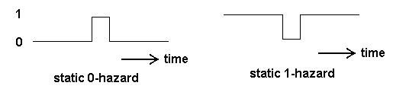
Static Hazard
A static hazard in a logic circuit is a transient change of an output value that is supposed to remain fixed during the transition between two input states.
There are 2 types of static hazard: static 0 hazard and static 1 hazard

Slide 15
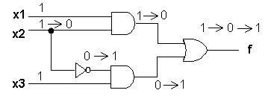
Example of Static 1 Hazard
Initially the input state (x1 x2 x3) = ( 1 1 1). The output f = 1.
Then input variable x2 is changed to 0. This change affects the top AND gate directly and its input goes to 0.
This change takes a little time to pass through the NOT gate, and thus when the top AND gate outputs 0, the bottom AND gate is still outputting 0. This causes the OR gate output to change from 1 to 0.
Once the change has passed through the NOT gate, the bottom AND gate outputs is 1, and the OR gate output will switch back to 1.

Slide 16
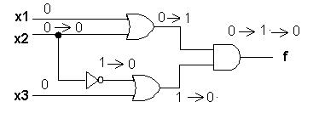
Example of Static 0 Hazard
1
Initially the input state (x1 x2 x3) = ( 0 0 0). The output f = 0.
Then input variable x2 is changed to 1. This change affects the top OR gate directly and its input goes to 1.
This change takes a little time to pass through the NOT gate, and thus when the top OR gate outputs 0, the bottom OR gate is still outputting 1. This causes the AND gate output to change from 0 to 1.
Once the change has passed through the NOT gate, the bottom OR gate outputs a 0, and the OR gate output will switch back to 0.

Slide 17
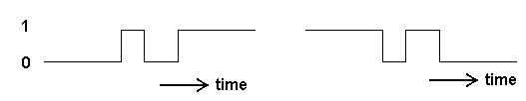
Dynamic Hazard
Dynamic hazards are momentary false outputs when a network is to change between 2 logic states. The picture below shows a dynamic hazard.

Slide 18
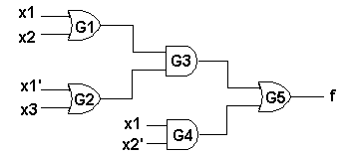
Example of Dynamic Hazard
If the input state (x1 x2 x3) = ( 0 0 0), the steady state output is f = 0. If the input state is (1 0 0), the output is f = 1.
Suppose that G3 and G5 have zero propagation delays, and G1 switches faster than G2, which is faster than G4.

Slide 19
Example of Dynamic Hazard (Contd.)
For the sake of simplicity, we shall assume that gates G1 produces a delay of 1 time unit, G2 produces a delay of 2 time units and G4 a delay of 3 time units.
Gates G3 and G5 will introduce no delays to the signal.

Slide 20
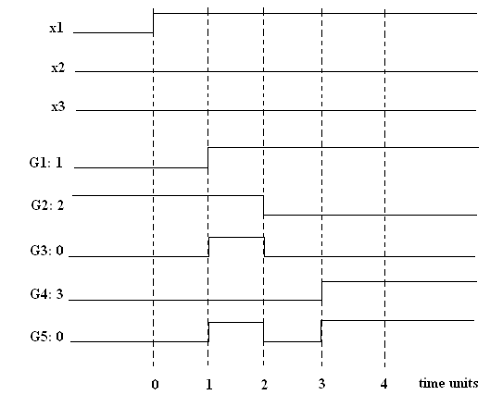
Example of Dynamic Hazard (Contd.)
The output which should change from ‘0’ to ‘1’ will glitch to ‘0’ momentarily before finally settling to ‘1’. This is an example of a dynamic hazard.

Slide 21
Detecting and Removing
Static 1 Hazard
Hazards can be detected using K-maps.
To detect static 1 hazard in a two level AND-OR circuit:
  Write down the SOP expression for the circuit
  Plot the minterms on K-map and loop them
  If any two adjacent 1’s are not looped, a static 1 hazard exists
To remove the hazard, loop the two 1’s.

Slide 22
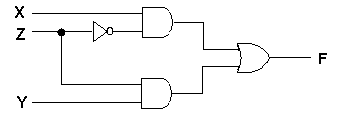
Hazard Elimination
Eliminating static hazard
  Consider the circuit:

Slide 23
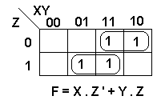
Hazard Elimination (Contd.)
The K-map of this circuit is shown below:
The output contains both Z and Z’ as inputs to the first level AND gates. This means that if the 2 AND gate outputs do not change at the same time when Z is changed, the circuit output can glitch to 0. This is a static 1-hazard.

Slide 24
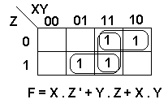
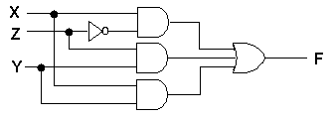
Hazard Elimination (Contd.)
We can prevent this glitch by adding an extra product term, the consensus of the 2 terms causing the problem. The new K-map now looks like:
The hazard-free circuit looks like this:

Slide 25
Detecting and Removing
Static 0 Hazard
Note that static 0 hazard occur primarily in OR-AND logic circuits that implement POS expression.
Static 0 hazard can be detected and eliminated using K-map:
To detect static 0 hazard in a two level OR-AND circuit:
  Write down the POS expression for the circuit
  Plot the maxterms on K-map and loop them
  If any two adjacent 0’s are not looped, a static 0 hazard exists.

Slide 26
Static & Dynamic Hazard Elimination
When using K-maps to design a combinational AND-OR circuit, we can eliminate static-1 hazards by circling all adjacent 1 terms.
When using K-maps to design a combinational OR-AND circuit, we can eliminate static-0 hazards by circling all adjacent 0 terms.
In general, to get rid of hazards, just loop all prime implicants.
If we eliminate all static 0 and static 1 hazards, dynamic hazards will not occur.

Slide 27
Summary
Combinational logic circuit
Adder
Comparator
Decoder
Encoder
Mux and Demux
Hazard
  Static 1
  Static 0
  Dynamic
  Elimination of hazard using K-maps

